Slide 1

Computer Architecture
Lecture – 3

Slide 2

Previous Concepts :
  Each activity in the computer is governed by instructions.
  So, to perform a specific task, corresponding program(set of instructions) for that task is brought into the processor from memory.
  Then the data needed for that operation is also brought from memory to processor.
  After that, the operation is executed.
Sumaiya Iqbal, Lecturer, CSE, BUET

Slide 3
Example 1 :
  Add LocA, R₀
  The steps required to perform the instruction :
    Fetch the instruction to the processor from memory
    Fetch the operand located at location A into processor
    The operand is then added to the content of Ro
    The added result is then stored in Ro
  So, this instruction needs both the memory access operation and ALU operation.
Sumaiya Iqbal, Lecturer, CSE, BUET

Slide 4
Sometimes to reduce the time needed to execute and improve the performance to execute one instruction, memory access and ALU operation are done in separate instructions.
Example 2 :
  Load LocA, R1 (Memory access operation)
  Add R1, R0 (ALU operation)
Sumaiya Iqbal, Lecturer, CSE, BUET

Slide 5
  Steps for instruction 1 :
    Fetch the instructions to the processor from memory
    Fetch the operand located at location A into R₁
  Steps for instruction 2 :
    The content of R1 is added to the content of Ro
    The added result is then stored in Ro
Sumaiya Iqbal, Lecturer, CSE, BUET

Slide 6
For transferring any operand from memory to processor, the address of the memory location of the operand must be sent to the memory unit.
This happens when corresponding control signal is issued.
After that data is transferred to or from the memory.
Sumaiya Iqbal, Lecturer, CSE, BUET

Slide 7

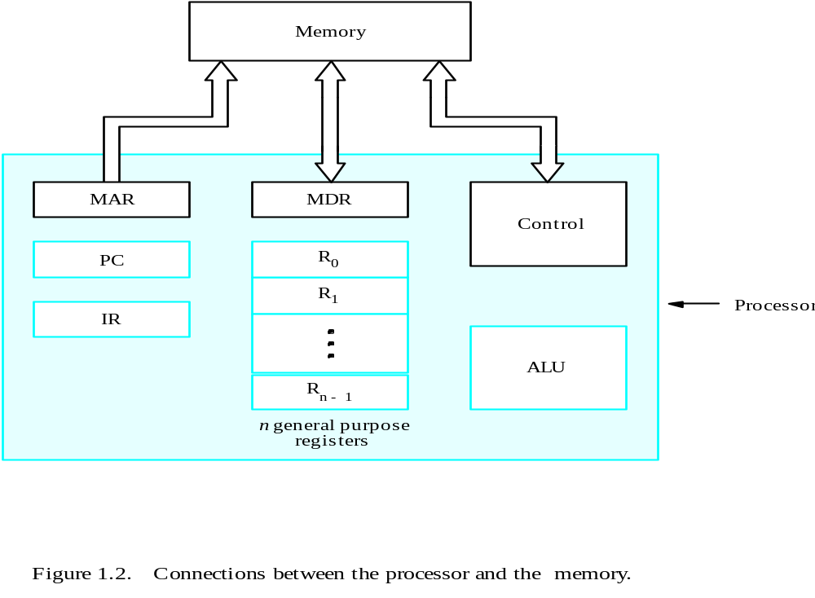
Sumaiya Iqbal, Lecturer, CSE, BUET

Slide 8

Beside the ALU and Control Unit, processor has some registers which has some specific purpose :
  Instruction Register (IR) :
    Holds the instruction that is currently being executed.
    Each of such instruction is executed under the command which is timing signal from control unit.
    So, the result of that instruction in IR is available in the control circuit, because
Sumaiya Iqbal, Lecturer, CSE, BUET

Slide 9
    The timing signals controls all the components which are necessary for the execution of that instruction.
  Program Counter (PC) : (how many execution succe…..
  A specialized register which keeps track of the execution of a program.
    During the execution of one instruction, it contains the address of the next instruction to be executed.
    So, the program counter actually points to the next instruction.
    During the execution of one instruction, the program counter is automatically updated.
Sumaiya Iqbal, Lecturer, CSE, BUET

Slide 10
  General Purpose Register :
    There are n general purpose registers, named R0 to Rn-1
    There role is to contain intermediate results of instruction execution
  Memory Access Register(MAR) and Memory Data Register(MDR) :
    Facilitate communication with the memory
    MAR contains the address of the memory that is to be accessed
    MDR contains the data that is to be read into or written out from the memory.
Sumaiya Iqbal, Lecturer, CSE, BUET

Slide 11

Operating steps of the execution of a program :
  Programs get into the computer through the input unit.
  Then the program resides into the memory.
  For execution, the program must be taken into the processing unit.
  For starting the execution the PC must point to the first instruction.
Sumaiya Iqbal, Lecturer, CSE, BUET

Slide 12

  Contents of the PC is then transferred to MAR
  A Read control signal is sent to the memory
  Within the time required to access the memory, the memory content is read from the specified address and loaded into MDR .
  In one such Read cycle only one word can be read, here the addressed word is 1st instruction of the program .
  MDR content is sent to IR.
Sumaiya Iqbal, Lecturer, CSE, BUET

Slide 13
  After entering into IR, the instruction is ready to be decoded and execute .
  If operation involves arithmetic computation then the operands must be fetched into ALU.
  The operands can be directly taken from input unit/can be within any general purpose register or, can be within memory, which is obtained in the previously descried Read Cycle.
  Only difference : In last step, MDR to ALU.
Sumaiya Iqbal, Lecturer, CSE, BUET

Slide 14
  Then ALU performs the desired operation
  If the result is to be stored in the memory, it is send from ALU to MDR.
  MAR is loaded with the memory address where the data is to be written and a Write cycle is initiated.
  At any point of execution, PC is automatically incremented so that it points to the next executable instruction.
Sumaiya Iqbal, Lecturer, CSE, BUET

Slide 15
  The normal execution of a program is done in the above way.
  But if an exceptional condition occurs during the execution of that program, the program execution is interrupted.
  Interrupt is a signal generated from any I/O device requesting service to the processor.
  Then, the processor first save the current internal state of the processor which includes, PC content, general register contents and some control information
Sumaiya Iqbal, Lecturer, CSE, BUET

Slide 16
  This current status is saved into memory.
  The processor then provides the requested service by executing an appropriate interrupt service routine.
  When interrupt service routine is completed, the saved state of the processor is restored.
  And again the execution of the program begins.
Sumaiya Iqbal, Lecturer, CSE, BUET

Slide 17

Zaky(Chapter 1 : 1.3)
Class Lecture
Sumaiya Iqbal, Lecturer, CSE, BUET

